Slide 1

Adventure Map Web System
Embark on a digital adventure with our innovative Adventure Map Web System. Explore interactive maps, solve engaging quizzes, and compete for top rankings.
Project created by
Tejas Buddhivant
Somnath Gatkul

Slide 2
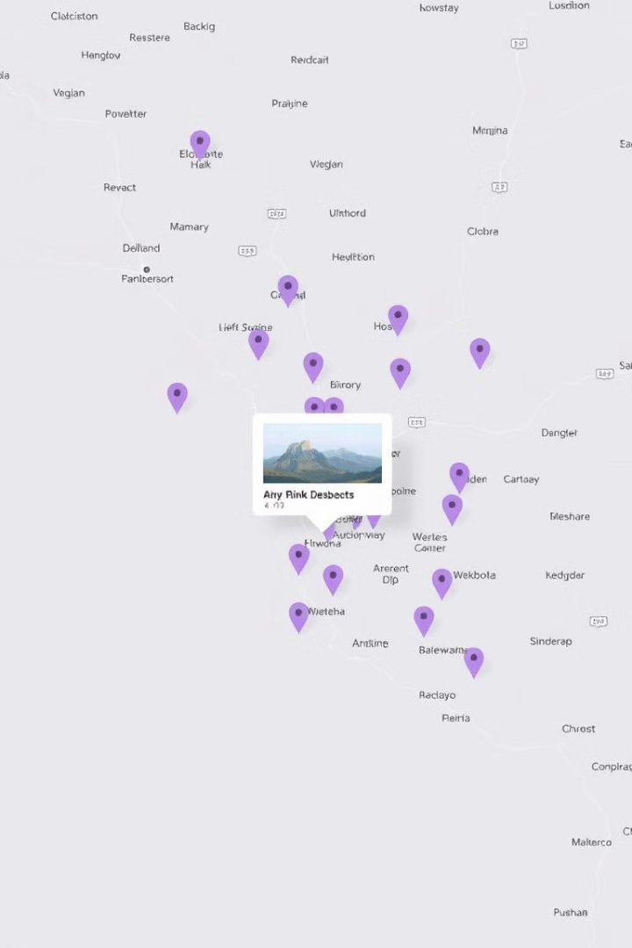
What is the Adventure Map Web System?
Interactive Exploration
Challenge and Discovery
Our system uses Google Maps to create engaging and immersive virtual journeys.
Navigate the map, discover hidden locations, and solve challenges to earn rewards.
Personalized Experience
Tailored to each user's progress, the system provides a dynamic and personalized adventure.

Slide 3

Leveraging Google Maps API
1
Powerful Tool
2
Real-World Data
The Google Maps API provides robust functionalities for map integration and customization.
Access to accurate and up-to-date geographic data for a realistic experience.
3
Seamless Integration
Effortless integration with our web system ensures a smooth and intuitive user interface.

Slide 4
Integrating Interactive Quizzes
Challenge and Engagement
Content Integration
Personalized Learning
Quiz questions are tailored to specific locations and themes, enhancing learning and exploration.
Quizzes provide immediate feedback, highlighting areas for improvement and promoting deeper engagement.
Interactive quizzes challenge users, test their knowledge, and add an element of fun to the experience.

Slide 5
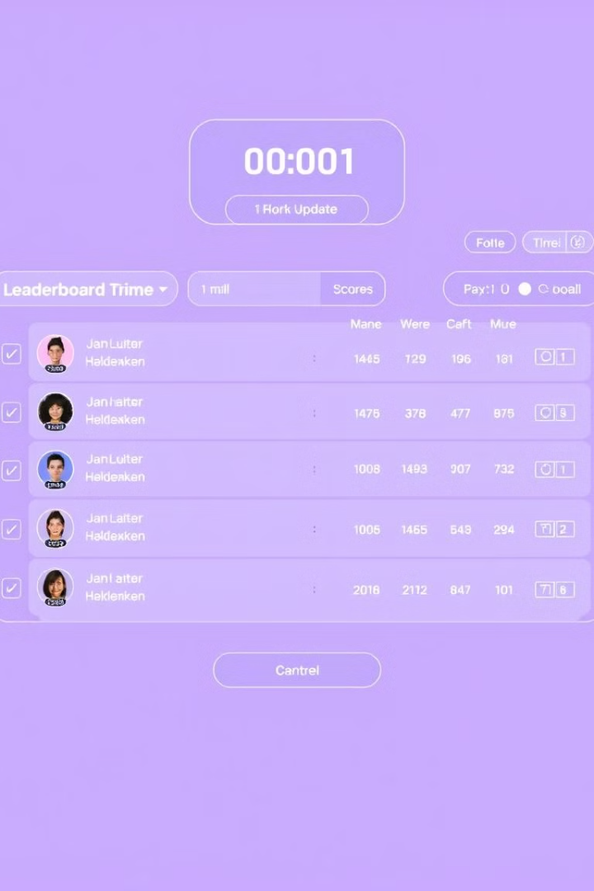



Participant Leaderboard and Ranking
Competition and Motivation
The leaderboard encourages users to compete, strive for higher scores, and improve their skills.
Real-Time Updates
Leaderboard rankings are updated in real-time, reflecting the latest achievements and progress.
Community Engagement
The leaderboard fosters a sense of community and friendly competition among participants.

Slide 6
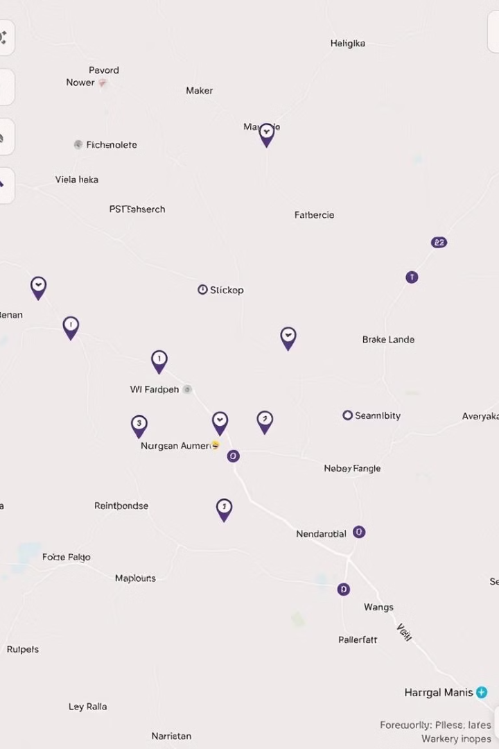
Customizable Map Overlays
Overlay Type
Description
Custom Markers
Add unique markers for specific locations or points of interest.
Routes and Paths
Define and display routes for users to follow, creating guided trails.
Information Layers
Overlay additional data like historical information, weather patterns, or wildlife sightings.

Slide 7


Unlocking Achievements and Badges
Recognition and Motivation
Gamified Experience
Progression and Engagement
Achievements provide a sense of accomplishment and encourage users to continue exploring.
Badges and achievements enhance the gamification of the Adventure Map system.
Unlocking new achievements motivates users to strive for higher levels and explore further.

Slide 8

Collaborative Exploration Features
1
Shared Exploration
Users can invite friends or colleagues to join their adventures, creating a shared experience.
2
Real-Time Communication
In-app chat features allow users to communicate with each other and collaborate on challenges.
3
Collaborative Problem Solving
Users can work together to solve quizzes, discover hidden locations, and achieve common goals.

Slide 9

Enhancing User Experience with Gamification
1
Increased Engagement
2
Enhanced Learning
3
Improved Retention
Gamification elements, such as points, badges, and leaderboards, create a fun and motivating experience.
The gamified approach makes learning more engaging and memorable, promoting deeper understanding.
Gamification elements encourage users to return to the system, increasing engagement and retention.

Slide 10


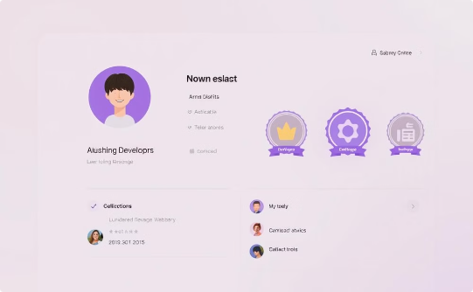
Implementing the Adventure Map System
API Integration
Quiz Development
Gamification Features
Integrate the Google Maps API to provide interactive maps and geographic data.
Develop interactive quizzes related to specific locations and themes.
Implement gamification elements, including achievements, badges, and leaderboards.

